Slide 1

Southern Hake trophic implementation with GADGET
Santiago Cerviño
IEO-Vigo (Spain)

Slide 2
GOALS:
Base hake model with GADGET
Trophic model
  Cannibalistic
  Blue whiting??
Link with WP4
Answer the question:
  Does hake food change recovery perception?

Slide 3
Question to answer:
  Does hake cannibalism changes recovery perception for south hake stock?

Slide 4
Model description
General features
Population model
  Cannibalism implementation
    Maximum consumption
    Suitability
    Energy Contents
    Proportion in diet
Fishery model
Likelihood and Parameters estimated
Results
Conclusions
Notes:
The original idea for the first implementation of GADGET to Southern hake is trying to replicate, as far as possible, the present assessment model based on XSA in order to have a reference to compare with. GADGET works as a forward projection, so it needs initial guesses to recruitment (age 0 1990 to 2005) and abundance at age for year 1 to 8+ in 1990. Following this order, fish are caught by the fleets with a defined selection pattern, afterwards it dies by natural mortality, then growths and ages. Other process may be applied with GADGET (migration, maturation, trophic relationships, recruitment, etc) but are not in implemented in the present model.

Slide 5
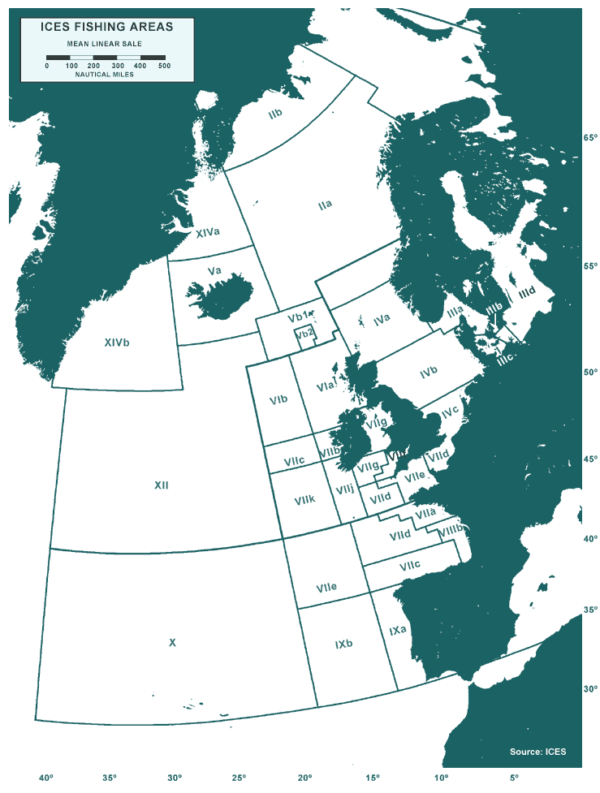
General features
One stock
Area
  Atlantic coast of Iberian Peninsula (without Gulf of Cadiz)
  ICES subDiv. VIIIc and IXa (Same than ICES stock)
Time
  From 1990 to 2005 (quarterly)
Ages
  0 to 8+
Length
  4 to 100 cm

Slide 6
Population model
Forward projection
Abundance (initial conditions):
  Abundance at age (1 to 7) in 1990 (estimated by the model).
  Recruits at age 0 from 1990 to 2005 (estimated by the model)
Growth Von Bertalanffy:
  loo=100, k=0.128 (Piñeiro and Sainza, 2003)
  Length weight relationship: a=0.00000659 b=3.01721 (ICES WGHMM)
M = 0.2 for all ages (ICES WGHMM)
Cannibalism implementation

Slide 7
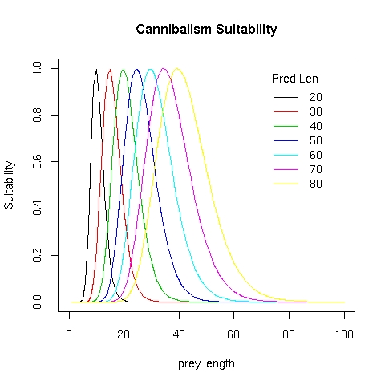
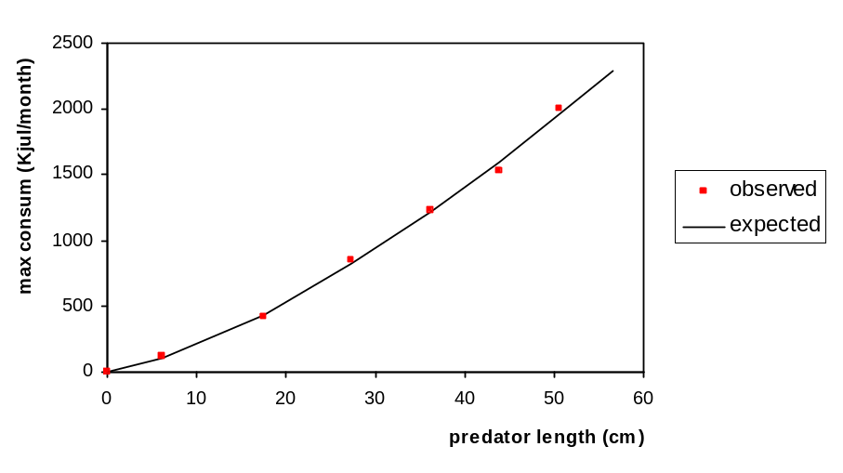
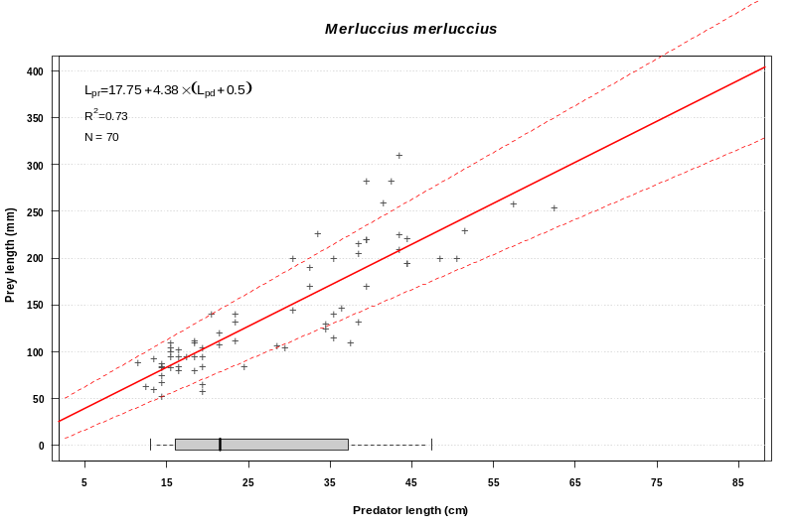
Cannibalism implementation
Suitability
Maximum consumption
Prey energy content
4.2 Kjul/gr
Likelihood data to estimate consumption:
Hake proportions in hake stomach
4th quarter from 1994 to 2006
Quarterly in 1994 and 1997
Notes:
All parameters estimated out of the model.

Slide 8
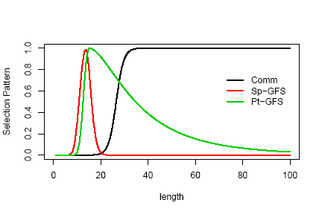
Fishery model
Commercial fleet length distribution modelled as logistic function.
Spanish and Portuguese survey modelled as “Andersen” function.

Slide 9
Parameters estimated
Name | number | description
age* | 7 | abundance at age in the initial population in 1990 (age1 to age7)
rec* | 16 | abundance in recruits per year (age 0) from 1990 to 2005
*comm | 2 | catch selection parameters in function ExponentialL50 (acomm and L50comm)
spsurv* | 3 | Spain survey selection parameters in function Andersen (SpSurv1, SpSurv3 and SpSurv4))
ptsurv* | 3 | Portuguese survey selection parameters in function Andersen (PtSurv1, PtSurv3 and PtSurv4)
Total: 31 parameters

Slide 10
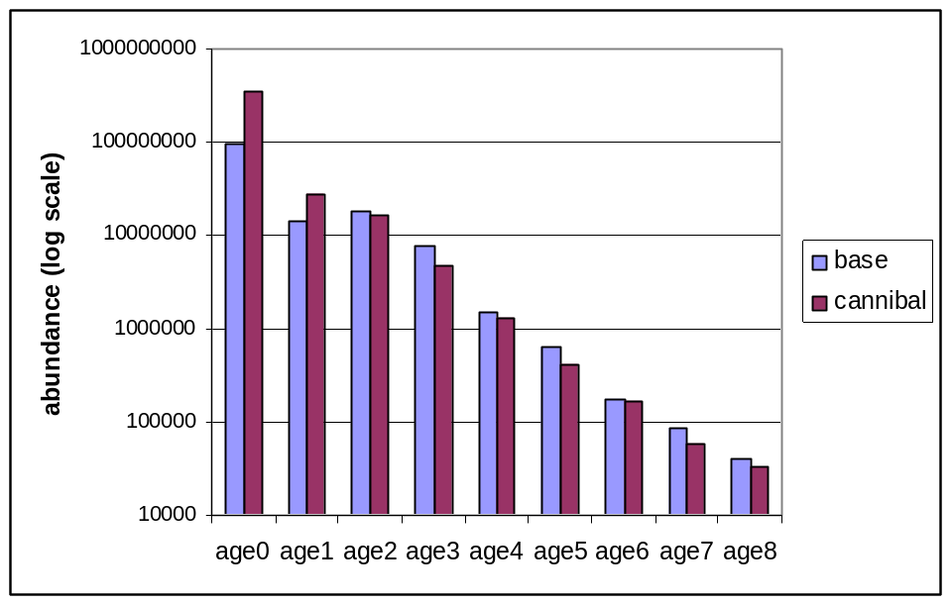
Results
Age structure in 2006 (initial conditions for predictions

Slide 11
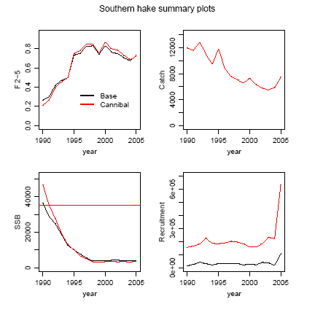
Results. Past and present status.

Slide 12
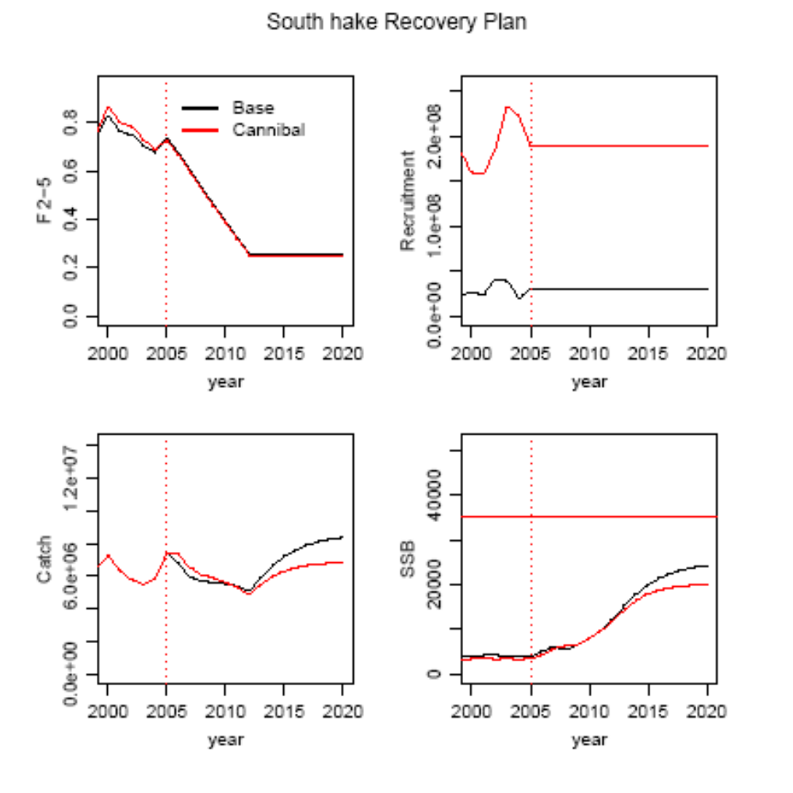
Results. Recovery Plan predictions.

Slide 13
Conclusions
Hake base model works properly with some weak features.
the incorporation of cannibalism process into the assessment model gives a different view:
  Age structure / recruitment
  more pessimistic recovery possibilities and future yield of Southern hake in medium and long term.

Slide 14
ToDos
Improve cannibalism process
  Produce understocking (>1.2%)
  Recruitment-growth-cannibalism??
Link with WP4
  Develop FLR management tool
  GADGET-FLR

